Slide 1

Customer success
Monthly support report
Lazar Milicevic
Key metrics, achievements, roadmap & next steps
January 2025

Slide 2
Agenda
1
Part I: Abstra support key metrics
2
Part II: Achievements & roadmap
3
Part III: Roadmap items
deep dive
4
Part IV: Product Insights
5
Part V: Next steps
6
Part VI: Executive Summary

Slide 3

Agenda
1
Part I: Abstra support key metrics
2
Part II: Achievements & roadmap
3
Part III: Roadmap items
deep dive
4
Part IV: Product Insights
5
Part V: Next steps
6
Part VI: Executive Summary

Slide 4
Abstra at a glance - Fullstory Metrics
Customer success: Monthly Support Report - January 2025
A general overview of numerical metrics and feature adoption compared with previous month
General Metrics
Catalog Metrics
Slide Viewer Metrics
Other Metrics
Active Users
129
-5.1%
Dataset Search
1078
+79.7%
Users
39
+44%
Target Directory Users
31
-+47.6%
New Users
22
0%
Dataset Views
3548
+57%
Sessions
378
+22.7%
Average session
per user
39
+28.6%
Abstra
Documentation
32
-11.1%

Slide 5
Key metrics overview
Customer success: Monthly Support Report - January 2025
General monthly key metrics
In January, there was a significant increase in the average first response time and total resolution time. This was primarily due to the creation of over 70 test tickets related to the Zendesk-AWS integration during the development, implementation, and testing phases. These test tickets artificially inflated response and resolution times, leading to temporary deviations in the metrics.
However, it is important to highlight that despite this temporary impact on operational metrics, we achieved a 100% satisfaction score, demonstrating that end users continue to receive high-quality support.
December
January
Change
Tickets Received
67
119
+77.61%
Solved/Received
92.54%
62.5%
-32.46%
Average First Response Time (Bus. hrs.)
1.4 hrs
4.9 hrs
250.00%
Average Full Resolution Time (Bus. hrs.)
8.8 hrs
66.9 hrs
660.23%
% Satisfied CSAT
78.6%
100%
+27.23%
*Times are in business hours.

Slide 6
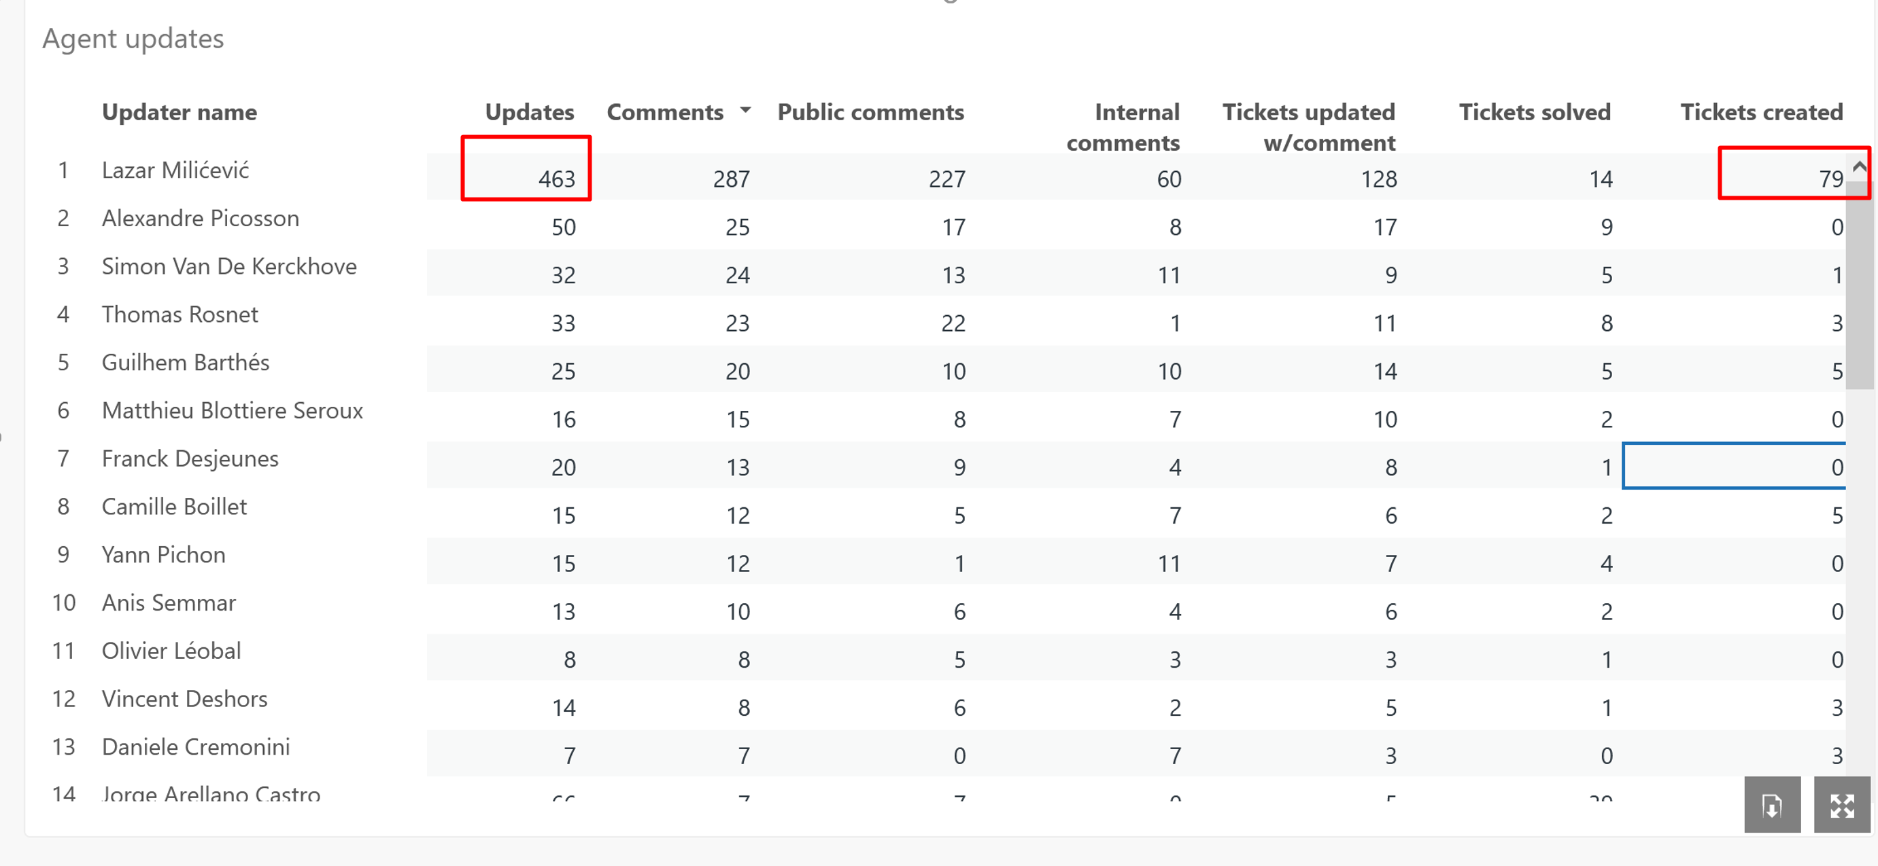
Monthly Ticket Counts & Average Resolution Times
Customer success: Monthly Support Report - January 2025
Compared with previous 3 months
2024/25
Tickets Received
Avg. Full Resolution Time
October
118
4.5 hrs
November
72
5.7 hrs
December
67
8.8 hrs
January - 2025
119
66.9 hrs
*Times are in business hours.
The 79 test tickets from the Zendesk-AWS integration had a major impact on the metrics, significantly inflating ticket volume and resolution times. My 463 updates reflect extensive testing, not real customer interactions. Despite this, the customer satisfaction remains 100%, proving that actual support quality was unaffected.

Slide 7
Blocking issues key metrics overview
Customer success: Monthly Support Report - January 2025
Monthly metrics and changes for the reported blocking issues
In January, the number of blocking issues decreased significantly, indicating system stabilization and overall improved support efficiency. The reduced number of such issues suggests that recent enhancements in the platform have led to fewer critical disruptions, and we expect this trend to continue in the coming months.
However, the average resolution time increased drastically due to extensive testing activities related to the AWS-Zendesk integration. More than 70 test tickets were created, which heavily impacted key metrics, artificially inflating response and resolution times.
Despite this, the lower number of actual blocking issues reflects a more stable environment, improved incident handling, and better proactive measures. As the system becomes more reliable, we anticipate a steady decline in major issues requiring urgent intervention.
December
January 2025
Change
Tickets Received
9
5
-44.44
Solved
9
5
-44.44%
Average First Response Time (Bus. hrs.)
4.1 hrs
3.3 hrs
-19.51%
Average Full Resolution Time (Bus. hrs.)
7.7 hrs
85.7 hrs
-1013%
*Times are in business hours.

Slide 8
Number of tickets received per topic
Customer success: Monthly Support Report - January 2025
Increasing tickets related to Dataset Creation as well as SageMaker issues.
Topic
Tickets
These are the topics that users can choose from when raising a ticket:
Dataset Creation Approval Request – Requests related to dataset creation approvals, including access and validation steps.
SageMaker issues different questions about SageMaker best practices
Dataset::Dataset Creation Approval Request
22
SageMaker Issues
17
Dataset::Data files management (ingesting, moving and deleting files)
6
Allowing CI to access codeartifact package registry
5
Create a new Abstra Project
5
Notes:
rank by desc order

Slide 9
Trend in topics received compared with previous month
Customer success: Monthly Support Report - January 2025
Highest changes in number of tickets received per topic
December
January 2025
Change
Dataset Data Files Management – Significant increase due to rising demand for access and integration needs.
CI Access to CodeArtifact – Marked growth driven by new project requirements and automation pipeline adjustments
Dataset::Dataset Creation Approval Request
23
22
-4%
SageMaker Issues
15
17
13%
Dataset::Data files management (ingesting, moving and deleting files)
0
6
100%
Allowing CI to access codeartifact package registry
0
5
100%
Create a new Abstra Project
0
5
100%

Slide 10
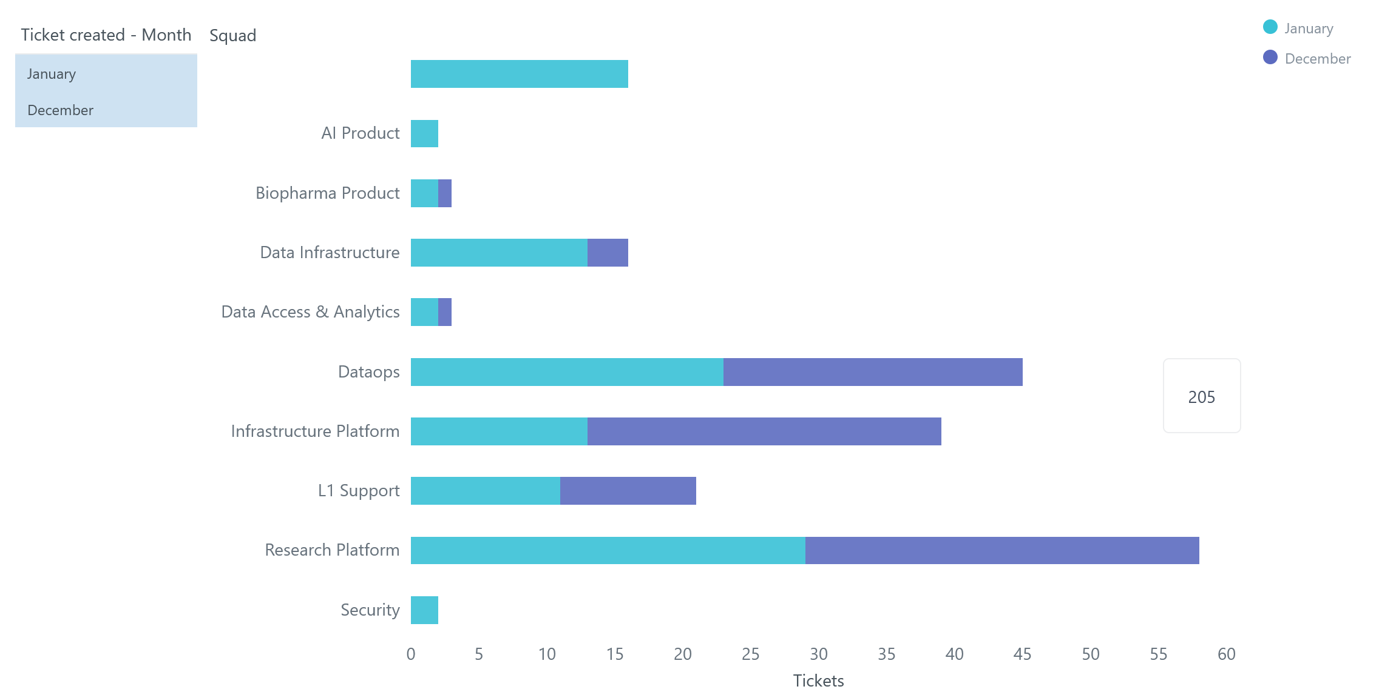
Tickets per squad
Customer success: Monthly Support Report - January 2025
Month-over-Month (MoM) Overview for ticket counts per squad
The Research Platform squad had a reduced share of tickets, indicating increased system stability and fewer issues related to SageMaker and workspaces.
Infrastructure Platform remained a key support area, handling a significant number of requests, primarily related to MLHub, Cytomine, GitHub repositories, and AWS access management.
Additionally, Data File Management and CI Access requests saw a notable rise, driven by growing needs for data processing, automation, and permission configurations.

Slide 11
Help Center article views - December 2024
Customer success: Monthly Support Report - January 2025
Most viewed help center articles in the month
Top articles viewed this month
Article
Views
Requesting compute resource for your workspace (AWS)
6
Abstra access requests
5
My workspace stopped despite being active
5
Sagemaker app is failing to start
3

Slide 12


🏆
Superstar of the month!
Part title
Alexandre Picosson
Handling most number of L2 tickets
Adrien Vaschalde
For having the least first response time of 0.1 business hours

Slide 13

Agenda
1
Part I: Abstra support key metrics
2
Part II: Achievements & roadmap
3
Part III: Roadmap items
deep dive
4
Part IV: Product Insights
5
Part V: Next steps
6
Part VI: Executive Summary

Slide 14
Customer success roadmap timeline
Customer success: Monthly Support Report - January 2025
Main topics we aim to achieve through Q1-25.
December
January
February
Handling 60% of ALL tickets at L1 level
Finalize Integrating Zendesk with AWS Support for SageMaker tickets
Educate users about the process workflow for SageMaker support
Reduce number of reported blocking issues by 50%
Finalize the process to handle internal vs external Abstra documentation
This slide is from the previous report, and I believe that we are making progress. The AWS-Zendesk integration has been successfully completed, and the only remaining task is user communication, which will be finalized in the coming days.

Slide 15
Agenda
1
Part I: Abstra support key metrics
2
Part II: Achievements & roadmap
3
Part III: Roadmap items
deep dive
4
Part IV: Product Insights
5
Part V: Next steps
6
Part VI: Executive Summary

Slide 16
Customer success Q1 Roadmap items (RIs)
Customer success: Monthly Support Report - January 2025
01
Abstra Global Support | AWS Support- Zendesk Integration
02
Leverage Fullstory insights
03
Abstra Documentation page visibility

Slide 17
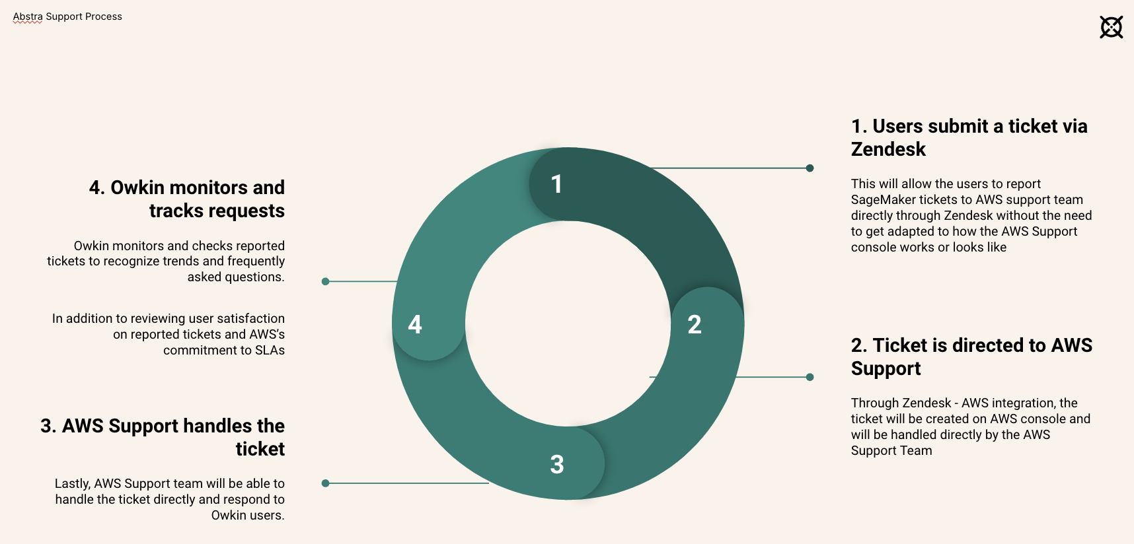
RI#1: Abstra Global Support
Process
AWS Support- Zendesk Integration
Customer success: Monthly Support Report - January 2025
🚀 Exciting Update! After weeks of effort, the Zendesk-AWS integration is finally in place and will go live in production by the end of this week!
During the last two weeks of January, we conducted over 100 test cases, created 100+ AWS console cases, processed 70+ Zendesk tickets, and posted 250+ comments to refine the workflow. Additionally, we developed over 1,000 lines of custom backend code in AWS Lambda to ensure seamless automation and a reliable support system.
With this in place, SageMaker tickets will now be automatically directed to AWS Support, streamlining operations and enhancing efficiency. We're excited to see it in action!
Workflow after SageMaker migration
Slide Deck

Slide 18
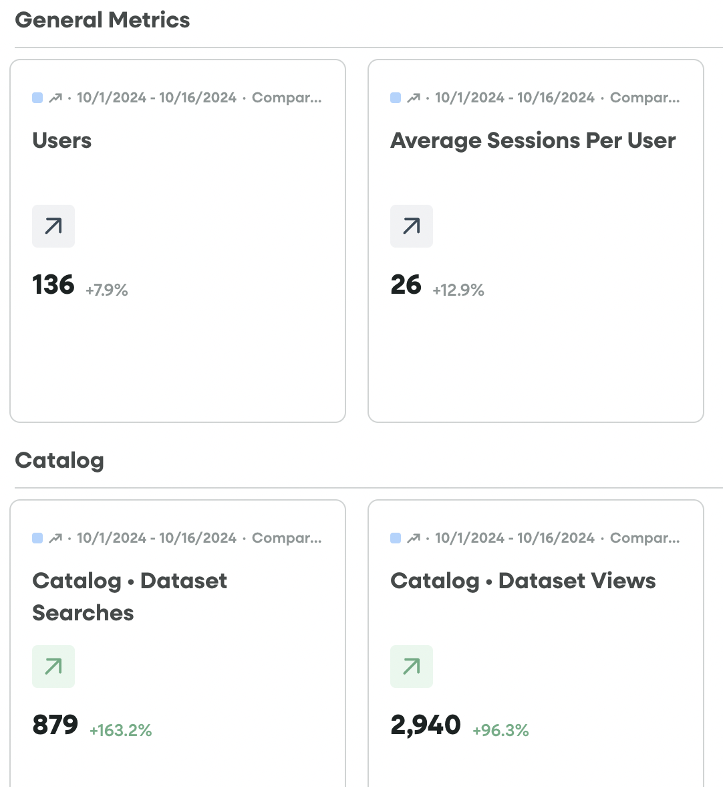
RI#2 Leverage Fullstory insights
Customer success: Monthly Support Report - January 2025
Find ways on setting up Fullstory to provide more insights to help us understand more about user’s journey when using Abstra
Track more metrics that are useful and find ways to obtain more product insights

Slide 19
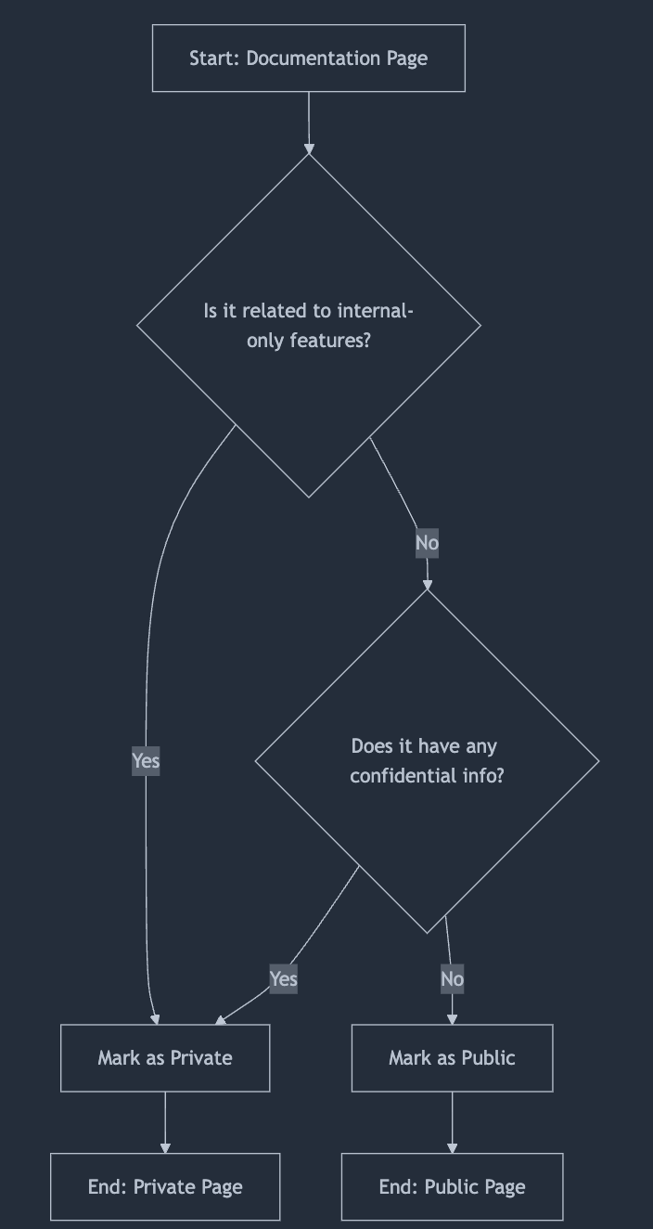
RI#3: Abstra Documentation page visibility
Customer success: Monthly Support Report - January 2025
(WIP) a solution where we can make pages visible per user organization
A decision-making process to decide whether a page in Abstra documentation should be private to internal Owkin users or public and can be viewed by external partners too. You may find the process here.
In addition to defining page visibility, it is also essential to review the existing documentation related to onboarding external users. We need to assess what information is currently available to them and identify any access limitations. Furthermore, the documentation should be updated to reflect recent company changes and process improvements, ensuring a more seamless and efficient onboarding experience.
I will be focusing on this throughout this month to ensure that the documentation is aligned with the latest updates and provides clear, structured guidance for external users.

Slide 20
Agenda
1
Part I: Abstra support key metrics
2
Part II: Achievements & roadmap
3
Part III: Roadmap items
deep dive
4
Part IV: Product Insights
5
Part V: Next steps
6
Part VI: Executive Summary

Slide 21
Next steps for Customer Success
Customer success: Monthly Support Report - January 2025
Finalizing Zendesk & AWS Support Integration
→ Ensure a smooth production rollout of the Zendesk-AWS integration this week.
→ Monitor early user interactions and address any unexpected issues.
Educate Users on the New SageMaker Support Process
→Launch a communication plan to introduce the new ticketing workflow.
→ Provide users with clear guidelines on how to submit tickets correctly and choose the right severity level.
→ Organize a knowledge-sharing session to help teams adapt to the new AWS support structure.
Please do not hesitate to reach out to me for any questions.
Review & Update External User Documentation
→ Conduct a full review of onboarding materials to align with recent process updates.
→ Identify any gaps in access permissions for external users and adjust documentation accordingly.
→ Ensure that all relevant changes are properly communicated and documented in Notion for future reference.

Slide 22
Agenda
1
Part I: Abstra support key metrics
2
Part II: Achievements & roadmap
3
Part III: Roadmap items
deep dive
4
Part IV: Product Insights
5
Part V: Next steps
6
Part VI: Executive Summary

Slide 23
Executive Summary
Customer success: Monthly Support Report - January 2025
Metrics summary
→ Tickets increased in January due to extensive AWS-Zendesk integration testing, with over 100 AWS cases and 70+ Zendesk tickets created.
→ Average first response time increas high number of test tickets but remains within SLA expectations.ed due to the
SageMaker Support Process - Zendesk/AWS Integration
→ The integration is now complete and will go live in production this week.
→ This will ensure SageMaker tickets are automatically routed to AWS Support, reducing manual handling and improving response efficiency.
→ Over 1,000 lines of custom AWS Lambda code have been developed to support the automation.
TL;DR - Most important points in one place!
Ongoing Issue - Documentation & User Access Review
→ A review of external user onboarding documentation is in progress to align with process changes and ensure proper access levels.
→ The goal is to identify missing permissions, improve documentation clarity, and provide a better user experience.
→ Updates will be finalized by the end of the month as part of the overall support improvement strategy.

Slide 24
Thank you!

